Slide 1








Carbon footprint report
Britplas Fabrications
Year 2
January – December 2023
Commit
Measure
Reduce
Engage

Slide 2

Step one.
Commitment

Slide 3



Carbon footprint report
Company Overview
Britplas Fabrications Ltd is a Private Limited Company, company number 03071310, registered in England & Wales with a registered address of Unit 18 Kingsland Grange, Woolston, Warrington, WA1 4RW.
Industry – Glazing & Other building completion and finishing
No of staff - 62 averaged over the reporting year including Directors
No of Offices: - 1
Accreditations – ISO 14001/9001/45001, Construction Line, FIRAS
Britplas Commercial is a leading UK contractor specialising in commercial glazing with a product portfolio that includes windows, curtain walling, door systems and security fencing.
Operating across the UK and internationally, we work with main contractors, architects and clients to design, install and manufacture glazing systems, including award-winning specialist proprietary products and standard systems.
Britplas recognises that both business and environmental sustainability will play a key role within our business foundations and values and has developed the following net-zero strategy.
© 2024 Sustainable Business Services

Slide 4
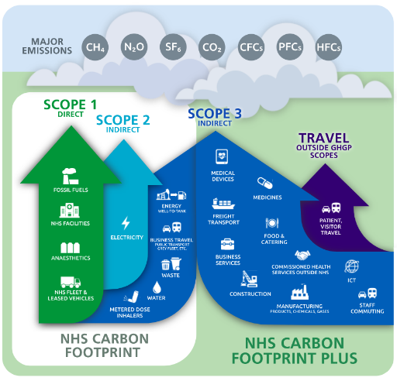
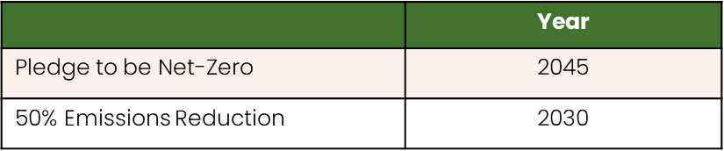
Carbon footprint report for Britplas
Our Climate Commitment – UNFCC Race to Zero & NHS Carbon Footprint Plus
Our company recognise`s that climate change poses a threat to the economy, nature and society-at-large, our company commits to act immediately in a full and lasting commitment by;
For our company to achieve Net Zero in line with the Science Based targets set out by the UNFCCC i.e., to achieve Net Zero no later than 2050 and target a 50% reduction in emissions by 2030.
To set realistic short- and long-term targets aligned to the NHS Carbon Footprint Plus, we will reach net zero (Scopes 1&2) by 2035, with an ambition to reach an 80% reduction by 2028 to 2032; & For the emissions we can influence (Scope 3), we will reach net zero by 2045, with an ambition to reach an 80% reduction by 2036 to 2039.
To maintain and report the total GHG emissions of our business regularly
In doing so, we are proud to be recognised by the United Nations Race to Zero campaign, and join governments, businesses, cities, regions, and universities around the world that share the same mission.
We acknowledge that our commitment will be reported on the SME Climate Hub website. Britplas Fabrications made our pledge to the Race to Zero in 2024
© 2024 Sustainable Business Services

Slide 5
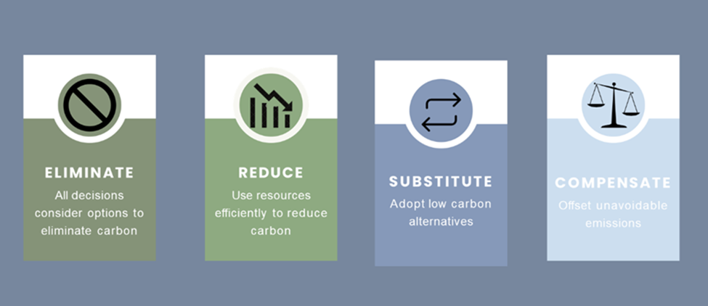
Carbon footprint report
Net-Zero Strategy
In determining our carbon reduction plan, we follow the Greenhouse Gas (GHG) Management Hierarchy set out by the Institute of Environmental Management and Assessment (IEMA). Britplas is committed to prioritising the elimination, substitution, and reduction of carbon in advance of any offsetting commitments.
Completed Carbon Reduction Initiatives
Britplas Fabrications have implemented the following measures to date to drive our net-zero strategy;
Installed and Environmental Management System to ISO 14001 standard
Working with external sustainability consultant to track, measure and reduce our carbon footprint
Added 3 charge stations at the office for charging staff cars
Engaged with a digital system (Deltek) that will heavily reduce the amount of paper produced in the business and on our sites
Switched to 100% renewable energy in the Office & Factory
© 2024 Sustainable Business Services

Slide 6
Step two.
Measure

Slide 7
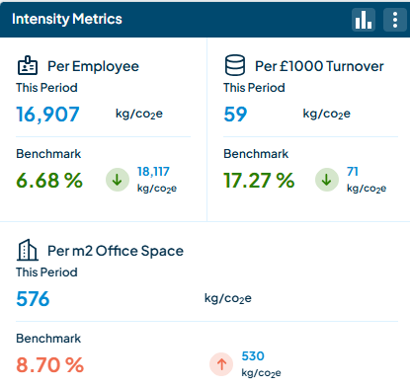

Carbon footprint report for Britplas
Total carbon emissions 1,055 tonnes Co2e
Reporting Year: January –December 2023
Britplas Fabrications emitted 1,055 tCO2e (tonnes of carbon dioxide equivalent) across scope 1, 2 and some 3 and reported using the operational control methodology, this is the equivalent to 628 long haul flights (London to New York)
This can be presented as an intensity indicator of 16.9 tCO2e per total full-time equivalent employee (FTE) or 576 kgCo2e per m2 office space.
© 2024 Sustainable Business Services

Slide 8
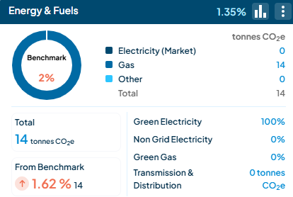
Carbon footprint - Buildings
Britplas operates from one office in Northwest England.
Electricity and gas emission were calculated using invoice data, meter reads and an apportionment calculation for our shared supply.
Britplas are on a 100% renewable energy tariff, the location-based emissions equivalent is 4 tCO2e.
We have included homeworking emissions using the BEIS emissions factors and total homeworking hours from, the business extrapolated over the year from an employee survey.
© 2024 Sustainable Business Services

Slide 9
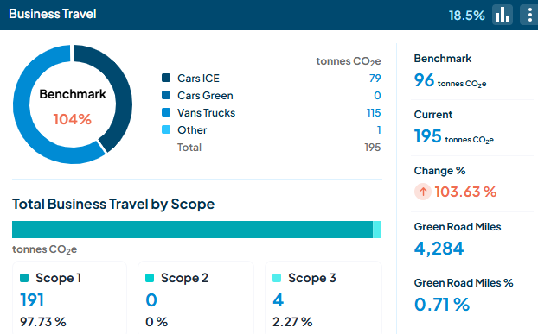
Carbon footprint - Travel
Britplas business travel is > 18% of recorded emissions for this reporting period and essential to deliver services to clients.
Mileage was recorded from our internal finance systems using monthly business mileage usage for cars.
Other travel such as trains and planes, data has been calculated using a combination of our travel booking system reports and estimations and calculations based on expense records.
© 2024 Sustainable Business Services

Slide 10
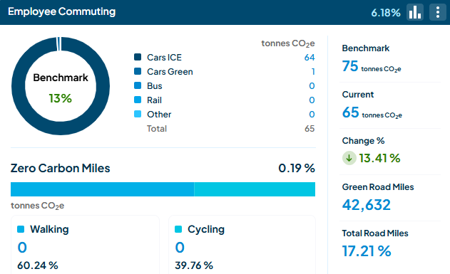
Carbon footprint - Commuting
As a manufacturing and service business, working from our office and production facility is essential to both make our products and develop the culture of our business.
Britplas commuting accounts for >6% of recorded emissions.
© 2024 Sustainable Business Services

Slide 11
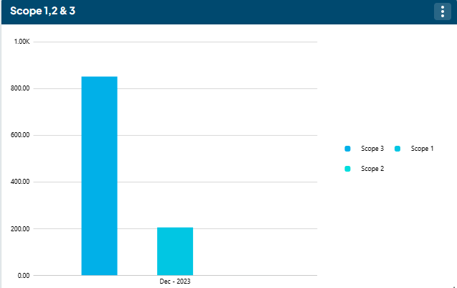
Carbon footprint – By Scope
Over 45% of recorded emissions related to our purchased goods and services, this is reflected in the breakdown of emission by Scope with 80% in Scope 3.
We are aware we have work to do in building out our recorded emissions, with particular focus on Scope 3 and are developing internal process and supplier relations to actively engage in the recording of our supplier's carbon data.
© 2024 Sustainable Business Services

Slide 12
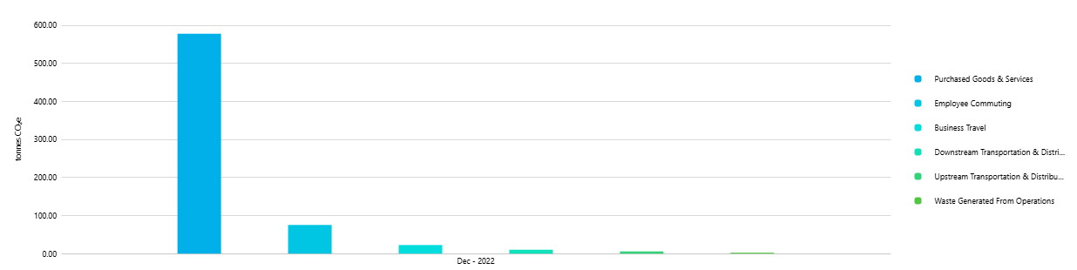
Carbon footprint – Scope 3
We are continuing to developing internal systems to record more scope 3 categories and a supplier charter to work in collaboration with our value chain to address the impact.
For this report we have used a combination of activity and extended environmental input output data to record key areas. The categories reported are;
1 – Purchased Goods & Services (partial)
4 – Upstream transportation & distribution
5 – Waste Generated in Operations
6 - Business Travel
7 – Employee Commuting
9 – Downstream transportation & distribution
Figure1: Britplas Scope 3 categories
© 2024 Sustainable Business Services

Slide 13
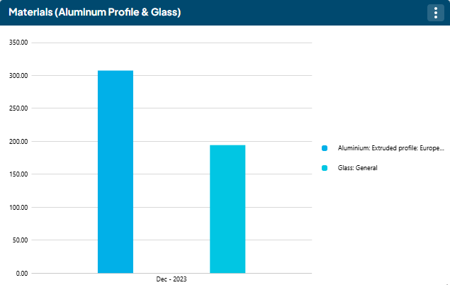
Carbon footprint – Scope 3
This image shows our 2 highest impact areas.
The materials procured and used to create our products, Aluminium & Glass.
We will begin to work with our key suppliers to create and impact register of all materials and suppliers to better inform decisions moving forward.
Figure 2: Britplas high impact Scope 3 areas - Materials
© 2024 Sustainable Business Services

Slide 14
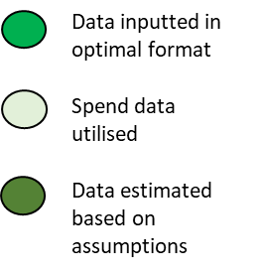
Methodology & Data Quality
This report has been created using the Environmental Reporting Guidelines, including Streamline Energy & Carbon Reporting guidance and PPN 06/21.
The report uses the operational control approach to establishing the boundary. The methodology adopted in line with the Greenhouse Gas Protocol and the BEIS Environmental Reporting Guidelines. The calculations were completed using the UK Government emissions factors and notch software including environmental input output factors.
© 2024 Sustainable Business Services

Slide 15
Step three.
Reduce

Slide 16
Carbon Hotspots
The following carbon hotspots have been identified from Britplas’ carbon footprint.
Business Travel - Fleet
Materials Used - Glass & Profile
Electricity & Gas
Purchased Goods & Services
© 2024 Sustainable Business Services

Slide 17
Business & Reduction targets
Action Plan & Targets:
Scope 3 - Supply Chain
We are committed to improving the quality and quantity of our Greenhouse Gas inventory and increasing engagement with our clients and supply chain to extend and improve the recorded scope 3 categories.
Britplas are committed to continuous data collection increasing the categories covered, with continuous learning and are implementing processes to record and understand more over future reporting periods.
Britplas will launch its Supply chain engagement program in 2024 working to support suppliers understand and calculate their own emissions for deeper understanding and collaboration, alongside assessing the materials we use to find more sustainable alternatives.
Business Travel
Other business travel is made up of trains, planes and hotels that are used to provide services to clients. Our future travel will consider the sustainable travel hierarchy to ensure we are lowering the impact whilst continuing to deliver services.
Utilities
Britplas will actively encourage a wider understanding of water and energy efficiency across the business, reducing office consumption and associated emissions whilst also supporting our homeworking staff use less and will set a target of reducing our usage
Britplas will undertake an energy audit and consider its findings.
Commuting
Britplas will continue to understand our people's commuting patterns and data and implement measures to reduce our environmental impact such as – bike to work and car share schemes – possibly EV salary sacrifice scheme
To support, monitor and manage our ambition we continue employ the services of a sustainability consultant and track our carbon footprint.
© 2024 Sustainable Business Services

Slide 18
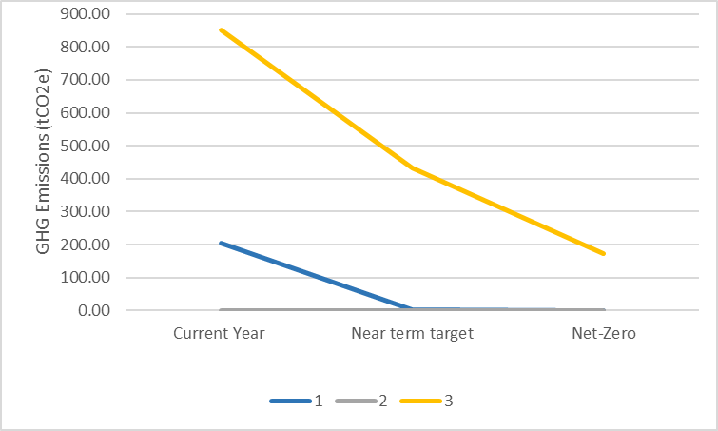
Business & Reduction targets
To align with 1.5 degrees global warming, Britplas needs to reduce its total GHG emissions by 50% for 2030.
The target years show Britplas GHG emissions targets in the years 2030, split by scope. If Britplas hits these targets, the company will be aligned with 1.5 degrees global warming.
Near term Scope 3 emission targets are to engage with 100% of suppliers and understand their carbon emission by 2030.
Long term Scope 1&2 targets are to reduce to 0 emissions and 100% renewable electricity.
Long term target is to achieve net-zero by 2045.
As an SME, it is not compulsory for Britplas to set a Scope 3 science-based target. However, it is strongly recommended that targets are set regardless, and increased reporting of Scope 3 emission categories is a priority next step.
Table 1: Britplas science-based targets and the required % reductions
Figure 3: Britplas’s science-based targets, split by scope.
© 2023 Sustainable Business Services

Slide 19
Step four.
Engage

Slide 20

Engage and communicate
Stakeholder engagement
Sustainability is in our DNA, we are passionate and committed to understanding more about our impact on the environment and communities.
We commit to actively talk about our journey to our staff, supply chain and clients and through social media and marketing to support further the workforce of a net-zero economy
Collectively we can make a difference.
© 2024 Sustainable Business Services

Slide 21
Engage and communicate
Declaration and sign off
This report has been created using the Environmental Reporting Guidelines¹, including Streamline Energy & Carbon Reporting¹ guidance and PPN 06/21². The report uses the operational control approach to establishing the reporting boundary. The methodology adopted is in line with the Greenhouse Gas Protocol³ and the Corporate Value Chain (Scope 3 ) Standard⁴.
The calculations were completed using the UK Government Greenhouse Gas conversion factors⁵ ,notch software, and Small World Consulting environmental input output factors⁶. And reviewed and signed off by SBS.
This Carbon Reduction Report & Plan has been reviewed and signed off by the board of directors.
Signed on behalf of Britplas Fabrications
J. Thoms
Jodie Thoms – Business Systems Manager
Date: 14.08.2024
1 - Environmental reporting guidelines: including Streamlined Energy and Carbon Reporting requirements - GOV.UK (www.gov.uk)
2 - Procurement Policy Note 06/21: Taking account of Carbon Reduction Plans in the procurement of major government contracts - GOV.UK (www.gov.uk)
3 - Homepage | GHG Protocol
4 - Corporate Value Chain (Scope 3) Standard | GHG Protocol
5 - Government conversion factors for company reporting of greenhouse gas emissions - GOV.UK (www.gov.uk)
6 - MRIO | Small World Consulting (sw-consulting.co.uk)
© 2024 Sustainable Business Services

Slide 22
Glossary

Slide 23

Glossary
Term | Definition
Carbon dioxide equivalent (Co²e) | Carbon dioxide equivalent (CO2e) is the unit of measurement which allows different greenhouse gases to be compared on a like for like basis relative to one unit of CO2.
Intensity indicator | Intensity indicators compare emissions data with an appropriate business metric or financial indicator, such as staff numbers, to allow comparison over time or with other organisations
Organisational boundaries | In setting organizational boundaries, a company selects an approach for consolidating GHG emissions and then consistently applies the selected approach to define those businesses and operations that constitute the company for the purpose of accounting and reporting GHG emissions.
Greenhouse Gas Protocol | GHG Protocol supplies the world's most widely used greenhouse gas accounting standards
UK Government emissions factors | These emission conversion factors are for use by UK and international organisations to report on and are updated annually, greenhouse gas emissions. From: Department for Business, Energy & Industrial Strategy
Scope 1 | Direct emissions that result from activities within your organisation’s control. This might include on-site fuel combustion, manufacturing and process emissions, refrigerant losses and company vehicles.
Scope 2 | Indirect emissions from any electricity, heat or steam you purchase and use. Although you’re not directly in control of the emissions, by using the energy you are indirectly responsible for the release of CO2.
Scope 3 | Includes all other indirect emissions that occur in a company value chain, eg purchased goods, travel and waste disposal
Carbon footprint | A carbon footprint is the total greenhouse gas (GHG) emissions caused directly and indirectly by an individual, organisation, event or product, and is expressed as a carbon dioxide equivalent (CO2e
Benchmark year | The initial reporting year to be used to set reduction targets against
Operational control | After a company has determined its organizational boundaries in terms of the operations that it owns or controls, it then sets its operational boundaries. This involves identifying emissions associated with its operations
© 2024 Sustainable Business Services

Slide 24
Thank you.
Get in touch
jodie.thoms@britplas.com
01925824317
britplas.com
hello@sbs.eco
01918155200
sbs.eco

